Slide 1
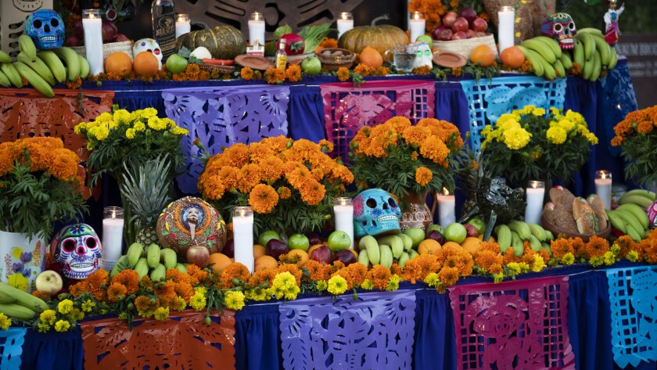
Dia de los Muertos October 31 – November 2
Student Health & Human Services
Office of Human Relations, Diversity & Equity
June 2022

Slide 2
Check in
If you could be anywhere else in the world right now, where would you be?

Slide 3
objectives
Learn about Dia de los Muertos
1
Discuss the importance of the holiday
2
Identify cultural traditions that are important to us
3

Slide 4
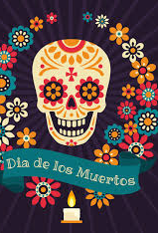
What is dia de los muertos?
a Mexican holiday celebrated throughout Mexico, in particular the Central and South regions, and by people of Mexican heritage elsewhere.
October 31 –November 2
involves family and friends gathering to pray for and remember friends and family members who have died.

Slide 5
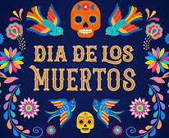
Why is the holiday important?
In Mexican culture, death is viewed as a natural part of the human cycle.
Mexicans view it not as a day of sadness but as a day of celebration because their loved ones awaken and celebrate with them

Slide 6
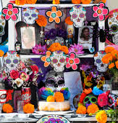
important parts of the day
The Ofrenda: altar created for the person who is being celebrated
Aztec marigolds: flowers used to decorate the ofrendas
Calaveras: skulls used to decorate the ofrendas
Favorite food and drink of the person being celebrated
Pan de Muerto: bread of the dead

Slide 7
Reflection
What do you think about this tradition?
Are there traditions in your culture that celebrate or honor people who have died?

Slide 8
Dia de los muertos
Notes:
Play the video for the students (5:16)
Mexican Day of the Dead – YouTube

Slide 9
Time to share
What is something new that you learned about Dia de los Muertos?
What is something that you liked about Dia de los Muertos?

Slide 10
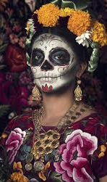
Check out
If you could add something to Dia de los Muertos, what would it be and why? (eg. Certain songs, food, art, etc.)

Slide 11
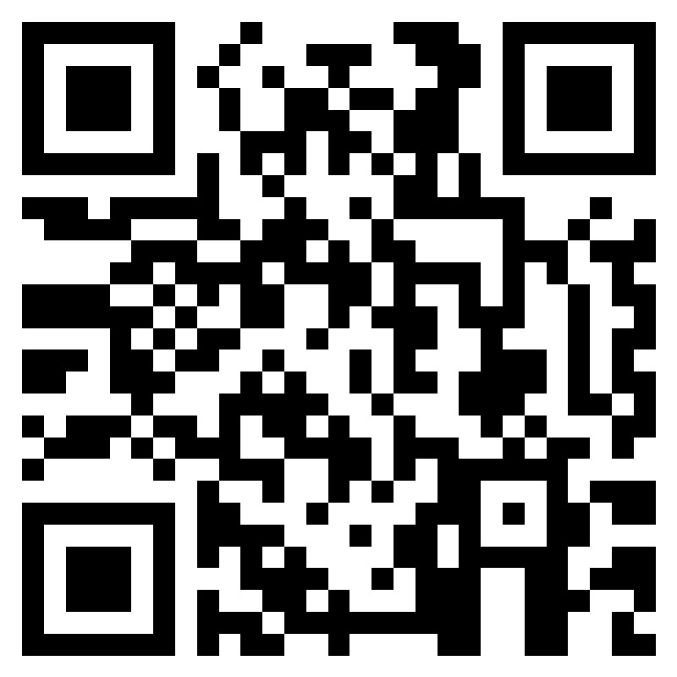
Teacher Survey
Notes:
Teacher please scan the QR code or click the following link to take a brief survey:
https://forms.office.com/r/i9UqyyxzTT

Slide 12
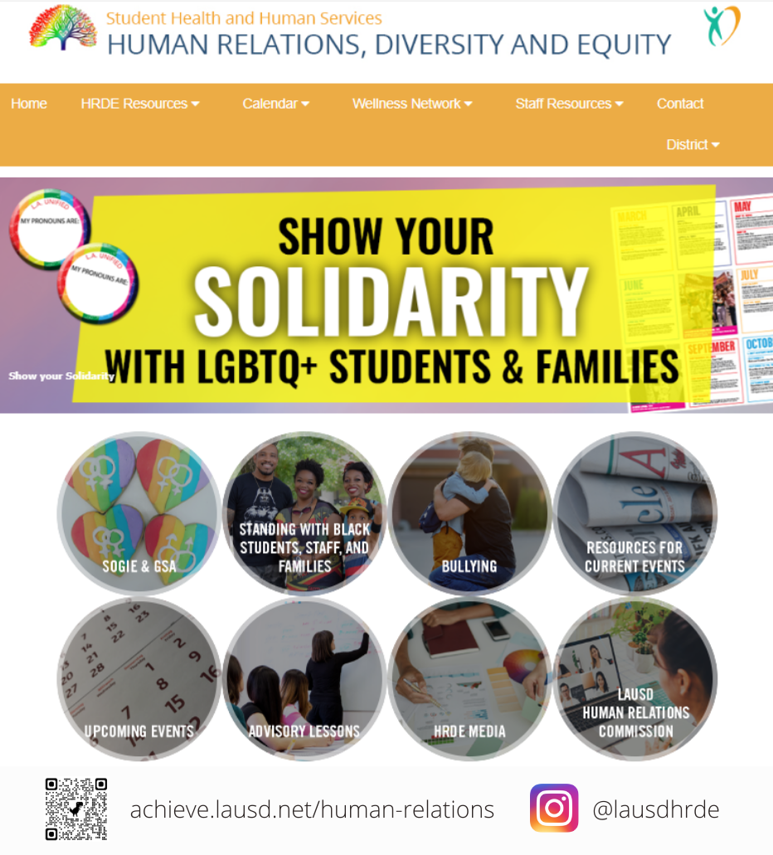
Office of Human Relations, Diversity & Equity achieve.lausd.net/human-relations

